Slide 1



SAME STATS
AM609L DSTT LAB
DEPT. OF APPLIED MATHEMATICS
DIFFERENT GRAPHS
STATISTICAL VALIDATION AND GEOMETRIC MORPHING VIA SIMULATED ANNEALING

Slide 2



TEAM
ANIRUDHHA PANDEY | 26-27-17 | M.TECH DATA SCIENCE
SOURABH DANG | 26-27-18 | M.TECH DATA SCIENCE
RITIK JOSHI | 26-27-16 | M.TECH DATA SCIENCE
ASTHA DESHMUKH | 26-14-06 | M.TECH MODELING & SIMULATION

Slide 3
PROBLEM STATEMENT
  Datasets are routinely reduced to mean, variance, correlation, and a regression line
  This abstraction is mathematically incomplete
  Very different distributions can produce identical summary statistics
  Without visualization, skewed or clustered data can pass as normal, leading to flawed models and corrupted data pipelines
Key message: Never trust the numbers without plotting the data.

Slide 4
OBJECTIVES
  Pure NumPy statistical engine: mean, variance, Pearson r, and OLS with no black-box libraries
  Anscombe’s Quartet validation: prove four distinct datasets share identical statistics
  Datasaurus Dozen validation: extend the proof to 13 complex shapes
  Stochastic shape morphing: use Simulated Annealing to turn one point cloud into another while keeping the statistics locked

Slide 5
LITERATURE FOUNDATION
  Anscombe (1973): numbers alone are not enough, so graph the data. His datasets calibrated our engine.
  Matejka & Fitzmaurice (2017) showed that point clouds can be steered into target shapes via Simulated Annealing. We adapted their acceptance rule:
P(Accept) = exp(−ΔCost / T)

Slide 6
PIPELINE & ETL (PHASE I)
FLOW: ETL → ANSCOMBE → DATASAURUS → SIMULATED ANNEALING
  Input: anscombe.csv, datasaurus.csv
  Strip nulls, resolve coordinate overlaps, cast to float64
  Output: anscombe_clean.csv, datasaurus_clean.csv
  Why: prevents floating-point errors from causing false rejections later

Slide 7
DATA SANITIZATION
  Why it matters: raw data must be clean before statistical processing, so the Simulated Annealing engine never sees corrupt values.
Extract → Transform → Load
  Extract: ingest the raw source files anscombe.csv and datasaurus.csv
  Transform:Strip null values
  Resolve coordinate overlaps
  Cast all spatial data to float64 precision
  Load: write new sanitized files, anscombe_clean.csv and datasaurus_clean.csv
  Impact: the annealing iterations run on pristine data, so floating-point rounding errors can’t trigger false rejections by the Gatekeeper.

Slide 8
STATISTICAL ENGINE (PURE NUMPY)
  Mean: x̄ = (1/n) Σxᵢ
  Variance (Bessel’s correction): s² = Σ(xᵢ − x̄)² / (n − 1)
  Pearson r = Σ(xᵢ − x̄)(yᵢ − ȳ) / √[Σ(xᵢ − x̄)² · Σ(yᵢ − ȳ)²]
  OLS: β = Σ(xᵢ − x̄)(yᵢ − ȳ) / Σ(xᵢ − x̄)², α = ȳ − βx̄

Slide 9
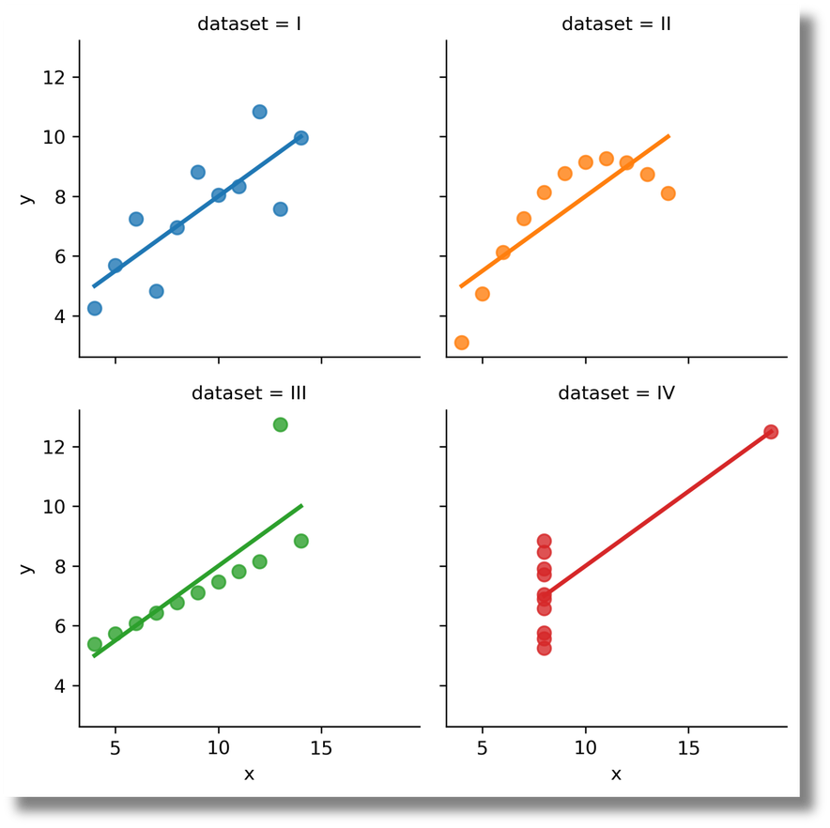
ANSCOMBE’S QUARTET RESULTS (PHASE II)
Metric | Value (all 4 datasets)
X mean | 9.00
Y mean | 7.50
X variance | 11.00
Y variance | 4.12
Correlation | 0.816

Slide 10
  What we did
    Proved that four very different datasets share identical statistics.
  How we did it
    Loaded anscombe_clean.csv (four separate coordinate arrays)
    Built a pure NumPy engine with no statistical libraries:
    Mean
    Variance (Bessel’s correction, n − 1)
    Pearson r
    OLS regression
  Calibrated the engine against Anscombe’s 1973 published values
Result (identical for all four datasets)
  X mean 9.00 | Y mean 7.50 | X variance 11.00 | Y variance 4.12 | r = 0.816 | y = 3.00 + 0.50x
  Takeaway: the plots are linear, curved, and outlier-driven, yet the numbers match.

Slide 11
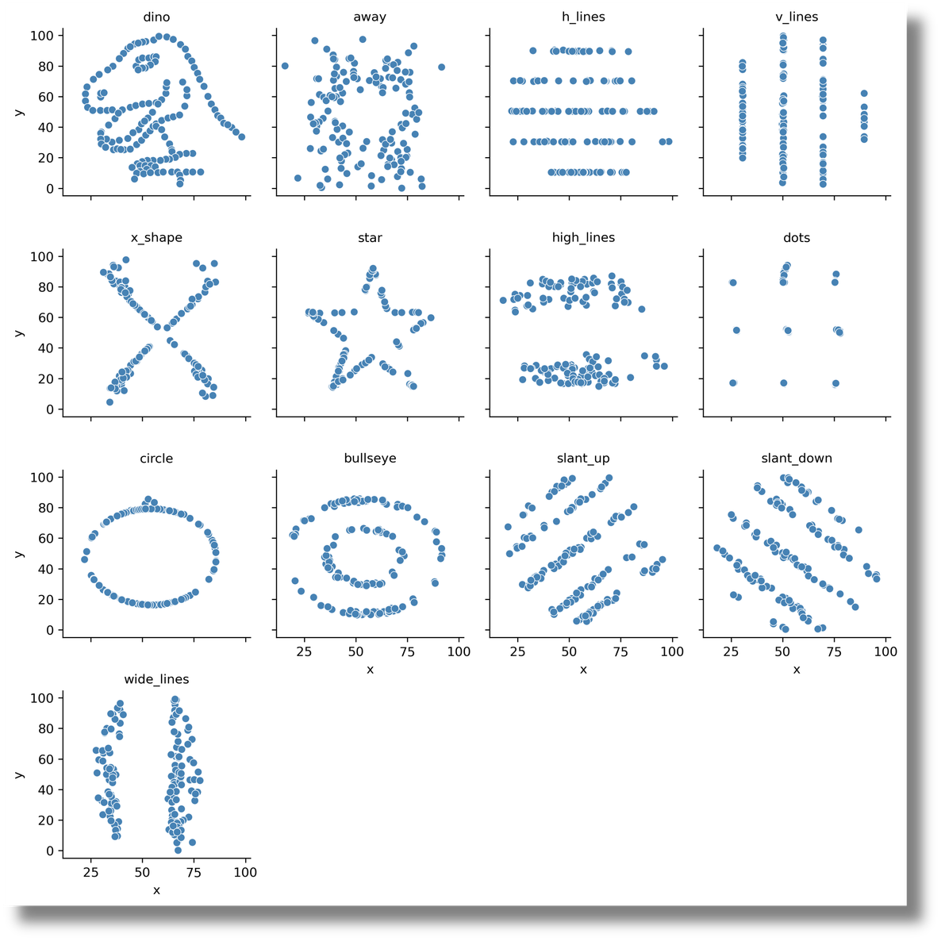
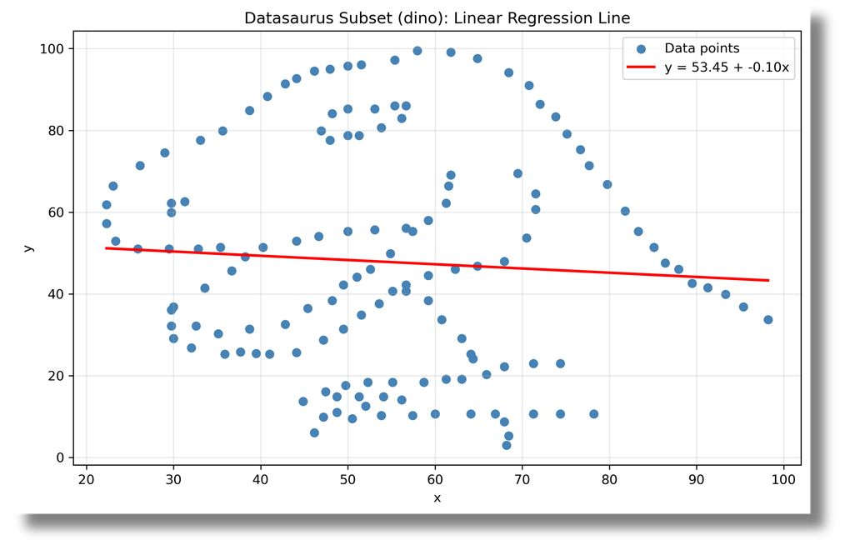
DATASAURUS DOZEN (PHASE III)
  13 distinct shapes (dino, star, circle, bullseye, x_shape, lines, etc.), same statistics
  Dino baseline:
    Mean X = 54.26, Y = 47.83
    Variance X = 281.07, Y = 725.52
    r = −0.0645
    OLS: y = 53.45 − 0.10x

Slide 12
  What we did
    Scaled the proof from 4 datasets to 13 complex shapes (dino, star, circle, bullseye, x_shape, lines, etc.).
  How we did it
    Loaded datasaurus_clean.csv
    Split it into subsets with Pandas groupby
    Ran the same NumPy engine on every subset
    Locked the dino subset’s statistics as the baseline constraints for Phase IV
Result (dino baseline)
  Mean X = 54.26, Y = 47.83 | Variance X = 281.07, Y = 725.52 | r = −0.0645 | y = 53.45 − 0.10x
  Takeaway: all 13 shapes return the same statistics, so summary numbers can hide extreme spatial differences.

Slide 13
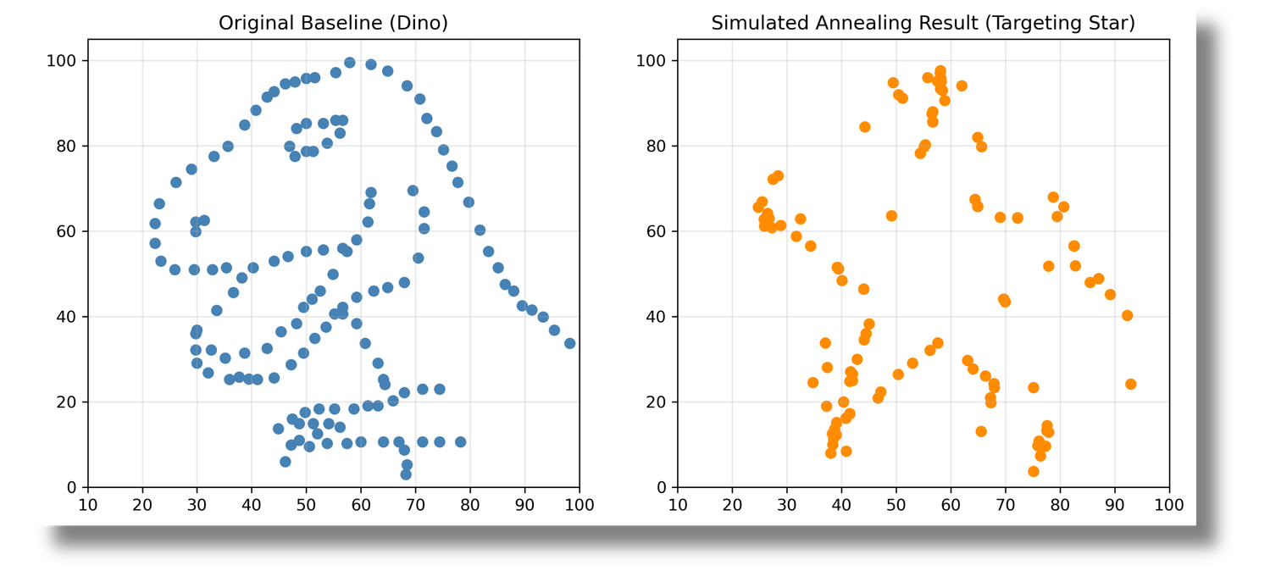
SIMULATED ANNEALING ENGINE (PHASE IV)
  Goal: morph dino → star
  Move: perturb a random point with Gaussian noise N(0, σ²)
  Cost: Euclidean distance to the star target
  Gatekeeper: reject any move where mean, variance, Pearson r, or regression drifts more than 0.1 from baseline
  Acceptance: better moves always accepted; worse moves accepted with probability exp(−ΔCost / T)
  Parameters: T₀ = 100, cooling 0.9995, 150,000 iterations

Slide 14
  What we did
    Morphed the dino point cloud into a star while keeping its statistics unchanged.
  How we did it
    Perturb: shift a random point with Gaussian noise N(0, σ²)
    Gatekeeper: recompute mean, variance, r, and regression; reject the move if any drifts more than 0.1 from baseline
    Cost: Euclidean distance to the star target
    Accept: better moves always; worse moves with probability exp(−ΔCost / T)
    Parameters: T₀ = 100, cooling rate 0.9995, 150,000 iterations
Result
  Cost fell from 1103.80 to 216.86, an 80.35% reduction in spatial divergence.
  Takeaway: data can be reshaped on purpose without triggering any statistical alarm.

Slide 15
CONCLUSION & REFERENCES
  Summary statistics are an incomplete description of data
  Different geometries can share identical mean, variance, correlation, and regression
  Data can be deliberately shaped without triggering statistical alarms
  Takeaway: always visualize before modeling
References
  Anscombe, F. J. (1973). Graphs in Statistical Analysis. The American Statistician, 27(1), 17–21.
  Matejka, J., & Fitzmaurice, G. (2017). Same Stats, Different Graphs. CHI 2017, 1290–1294.

Slide 16
Thank You

